Slide 1
Cognitive Security: Background
INST408C: Cognitive Security | Fall 2021 | SJ Terp

Slide 2
Misinformation, Disinformation, Malinformation, Rumours,
Conspiracies…

Slide 3
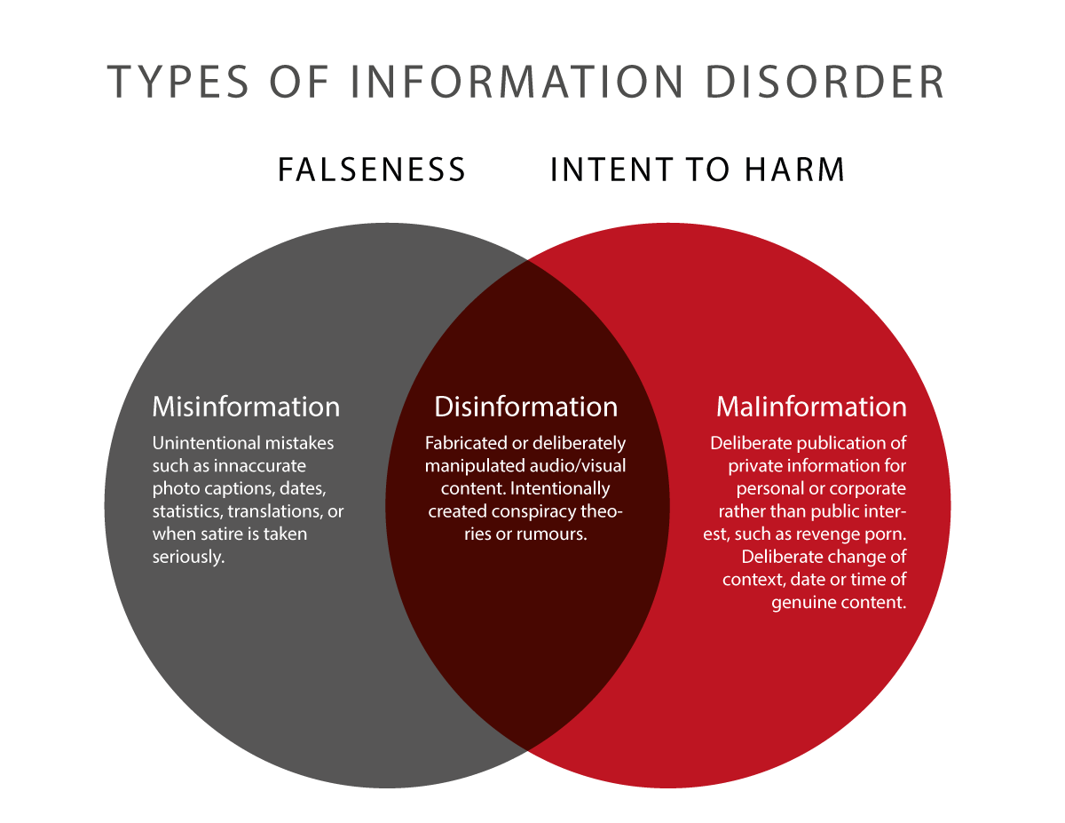
Media: Information Disorder
Notes:
Image: Wardle’s “information disorder”

Slide 4
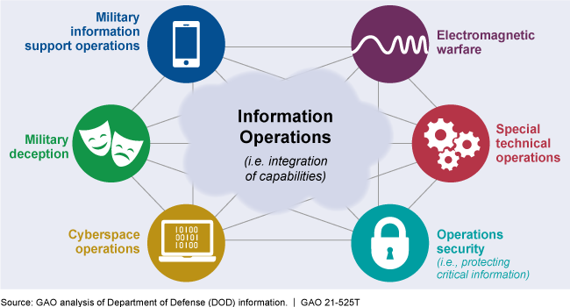
Military: Information Operations

Slide 5
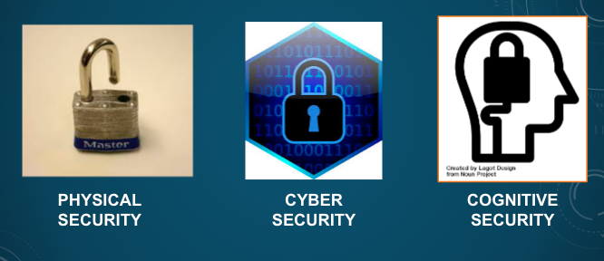
Information Security: Cognitive Security

Slide 6
Information Security vs Cognitive Security
Computers
Networks
Internet
Data
Actions
People
Communities
Internet
Beliefs
Actions

Slide 7
What we took from information security

Slide 8
CIA: Disinformation as an Integrity problem
Confidentiality: only the people/systems that are supposed to have the information do
Integrity: the information has not been tampered with
Availability: people can use the system as intended
Notes:
Danny Rogers, Black Hat / Forbes

Slide 9
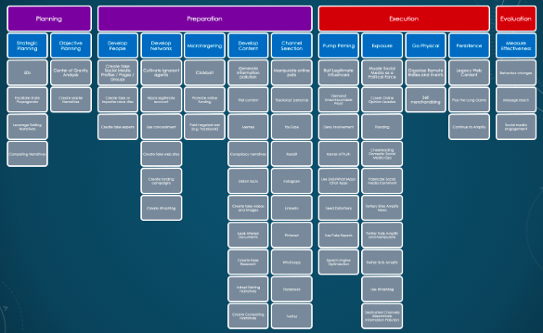
Frameworks: ATT&CK
Notes:
SJ Terp et al

Slide 10
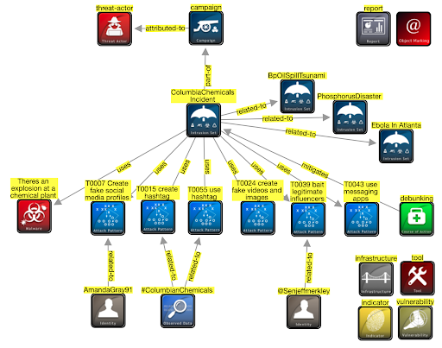
Frameworks: STIX

Slide 11
Disinformation as a risk management problem
Manage the risks, not the artifacts
Attack surfaces, vulnerabilities, potential losses / outcomes
Risk assessment, reduction, remediation
Risks: How bad? How big? Who to?
Mis/disinformation is everywhere:
Where do you put your resources?
Detection, mitigation, response
People, technologies, time, attention
Connections

Slide 12
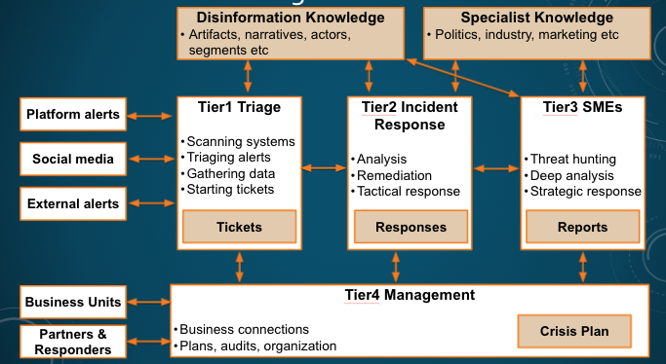
Tiered Security Operations Centers

Slide 13
What we’re dealing with

Slide 14
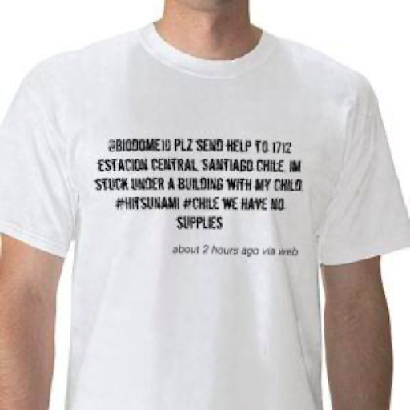
Simple attention-grabbing
Notes:
Image: 2010 red cross t-shirt

Slide 15
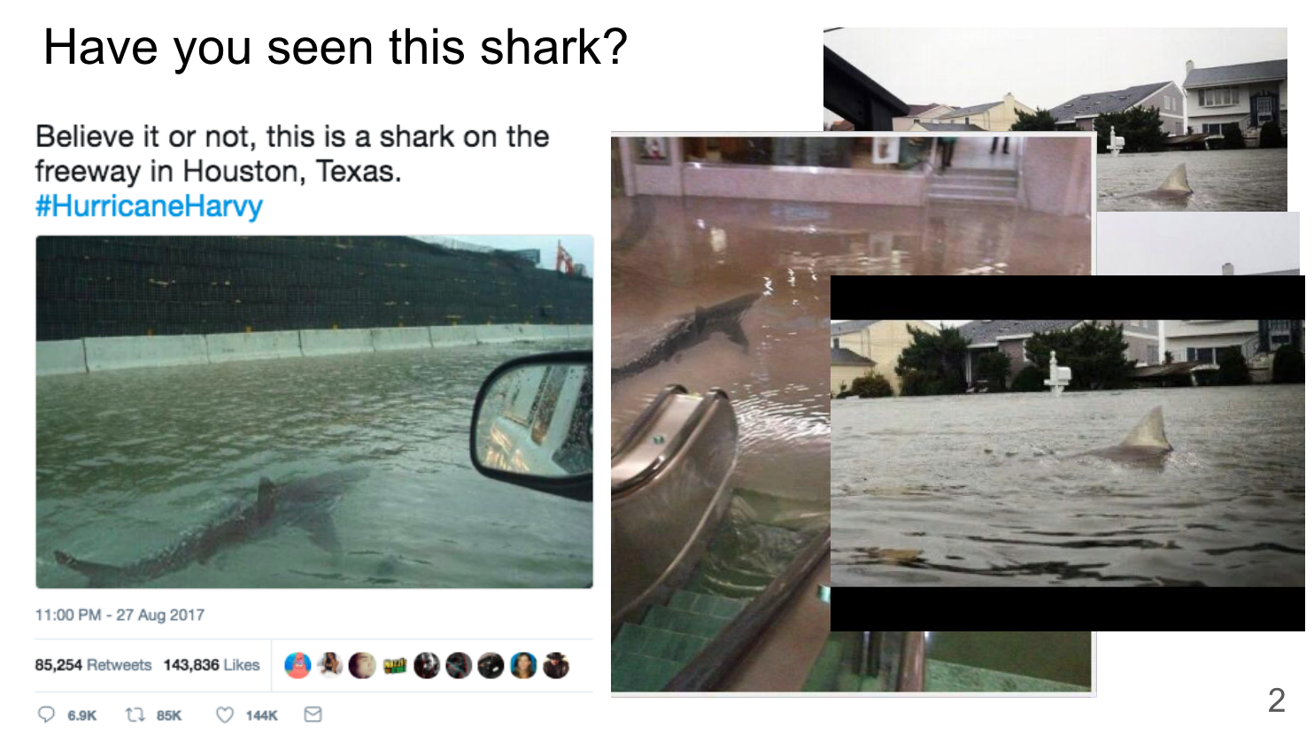
Repeated attention-grabbing

Slide 16
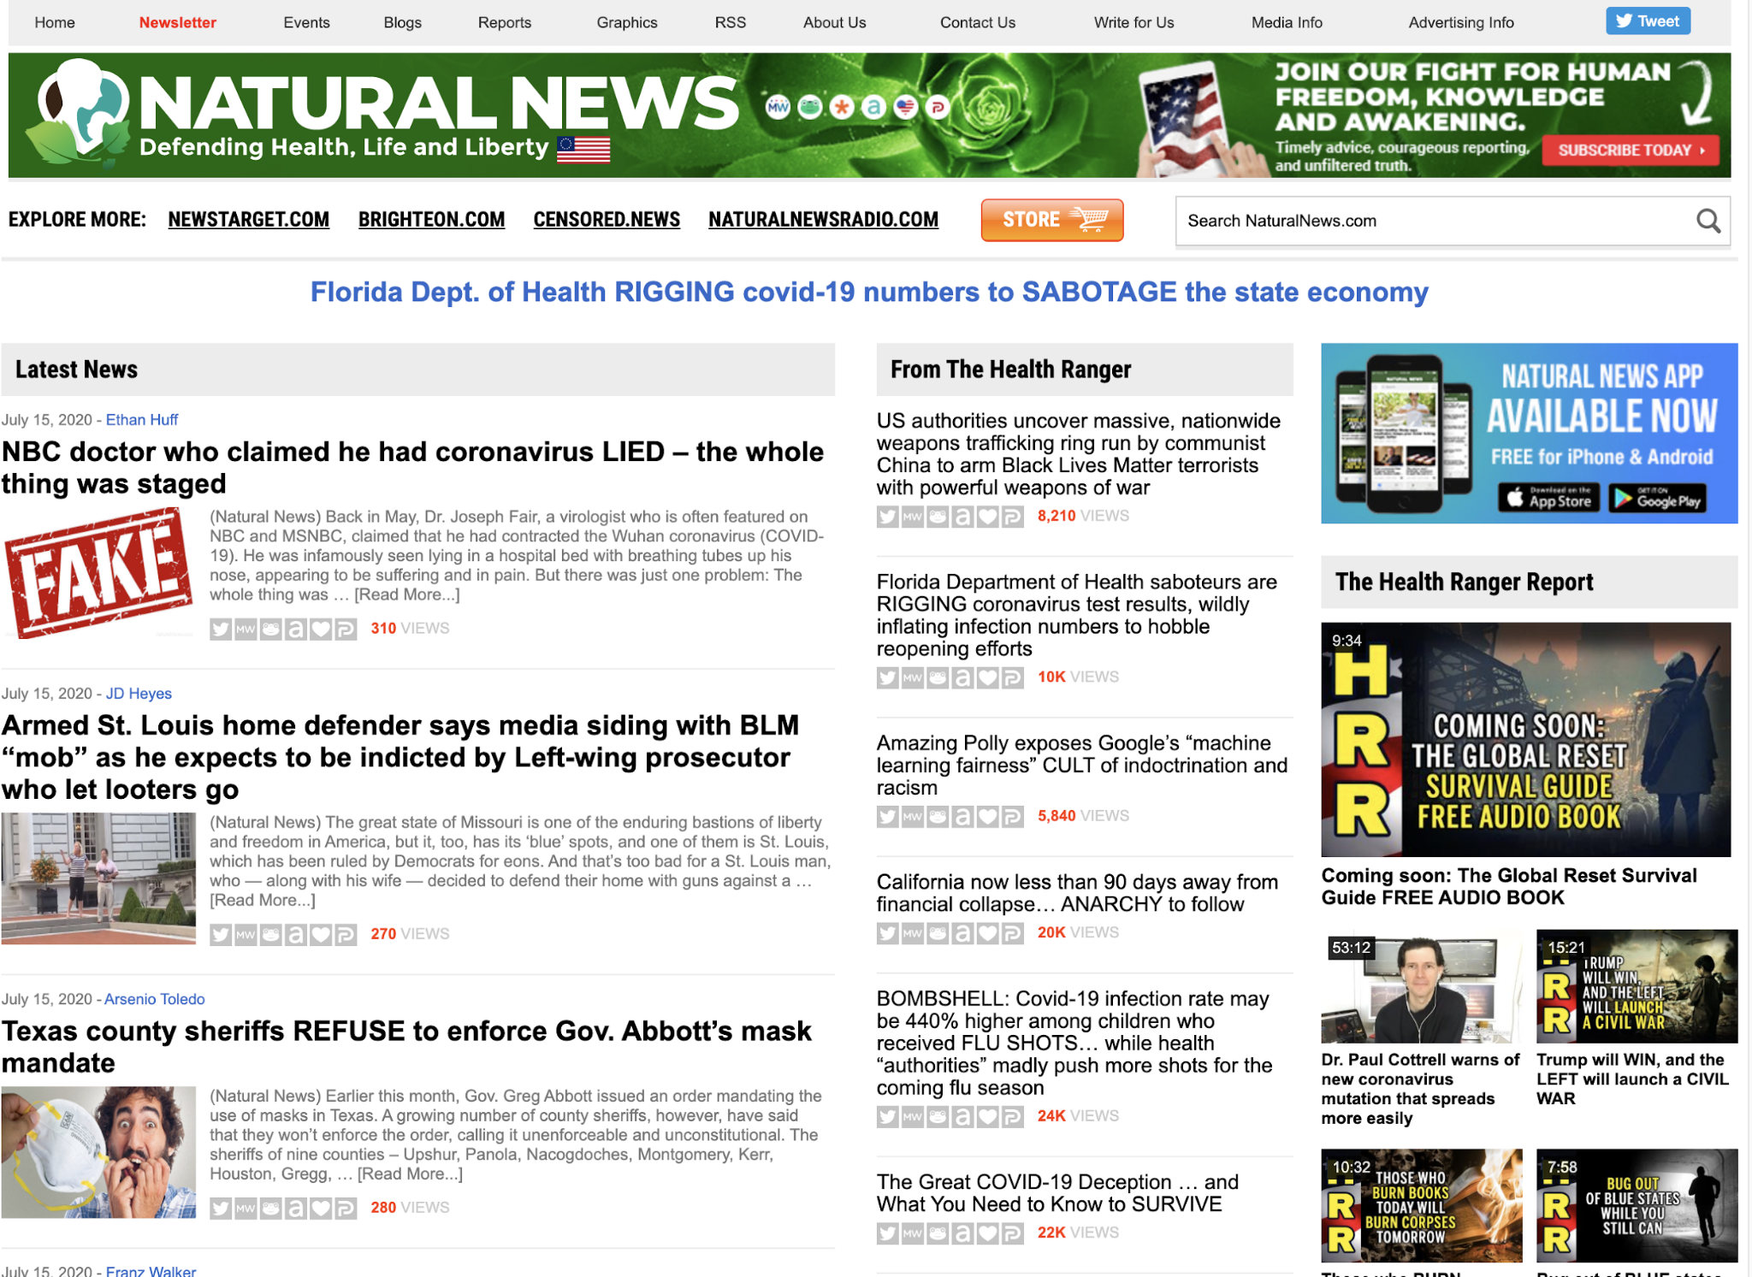
For Money

Slide 17
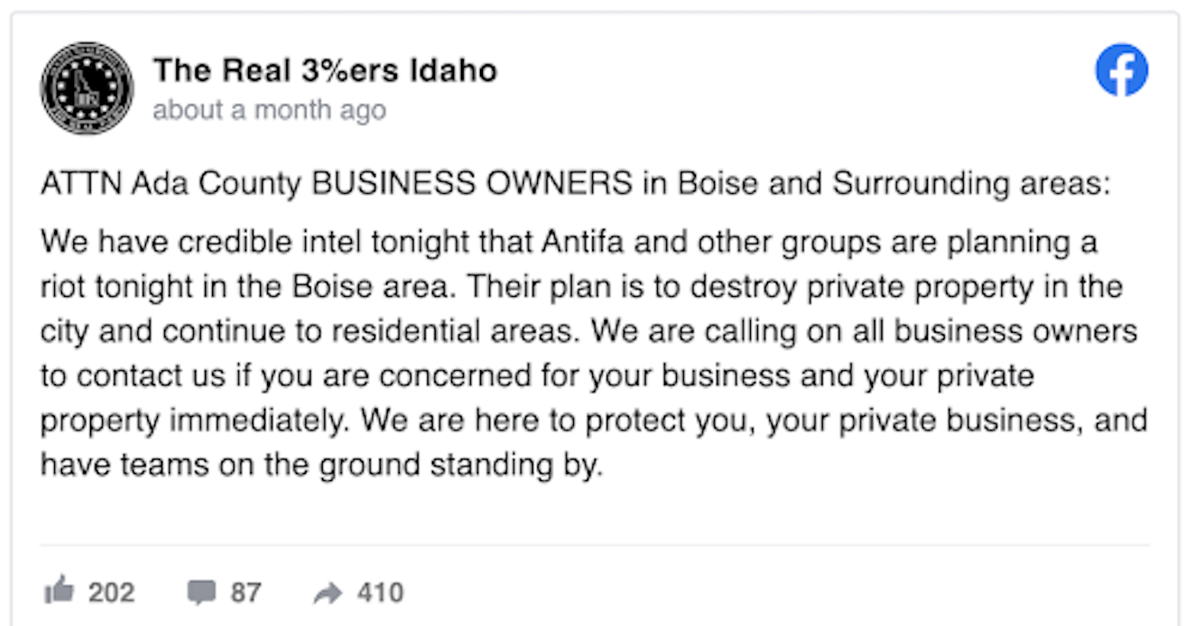
Boosting extremism

Slide 18
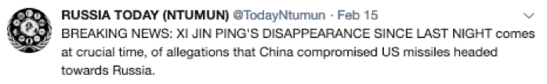
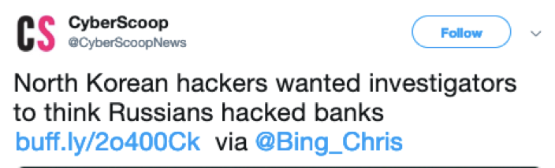
For Geopolitics

Slide 19
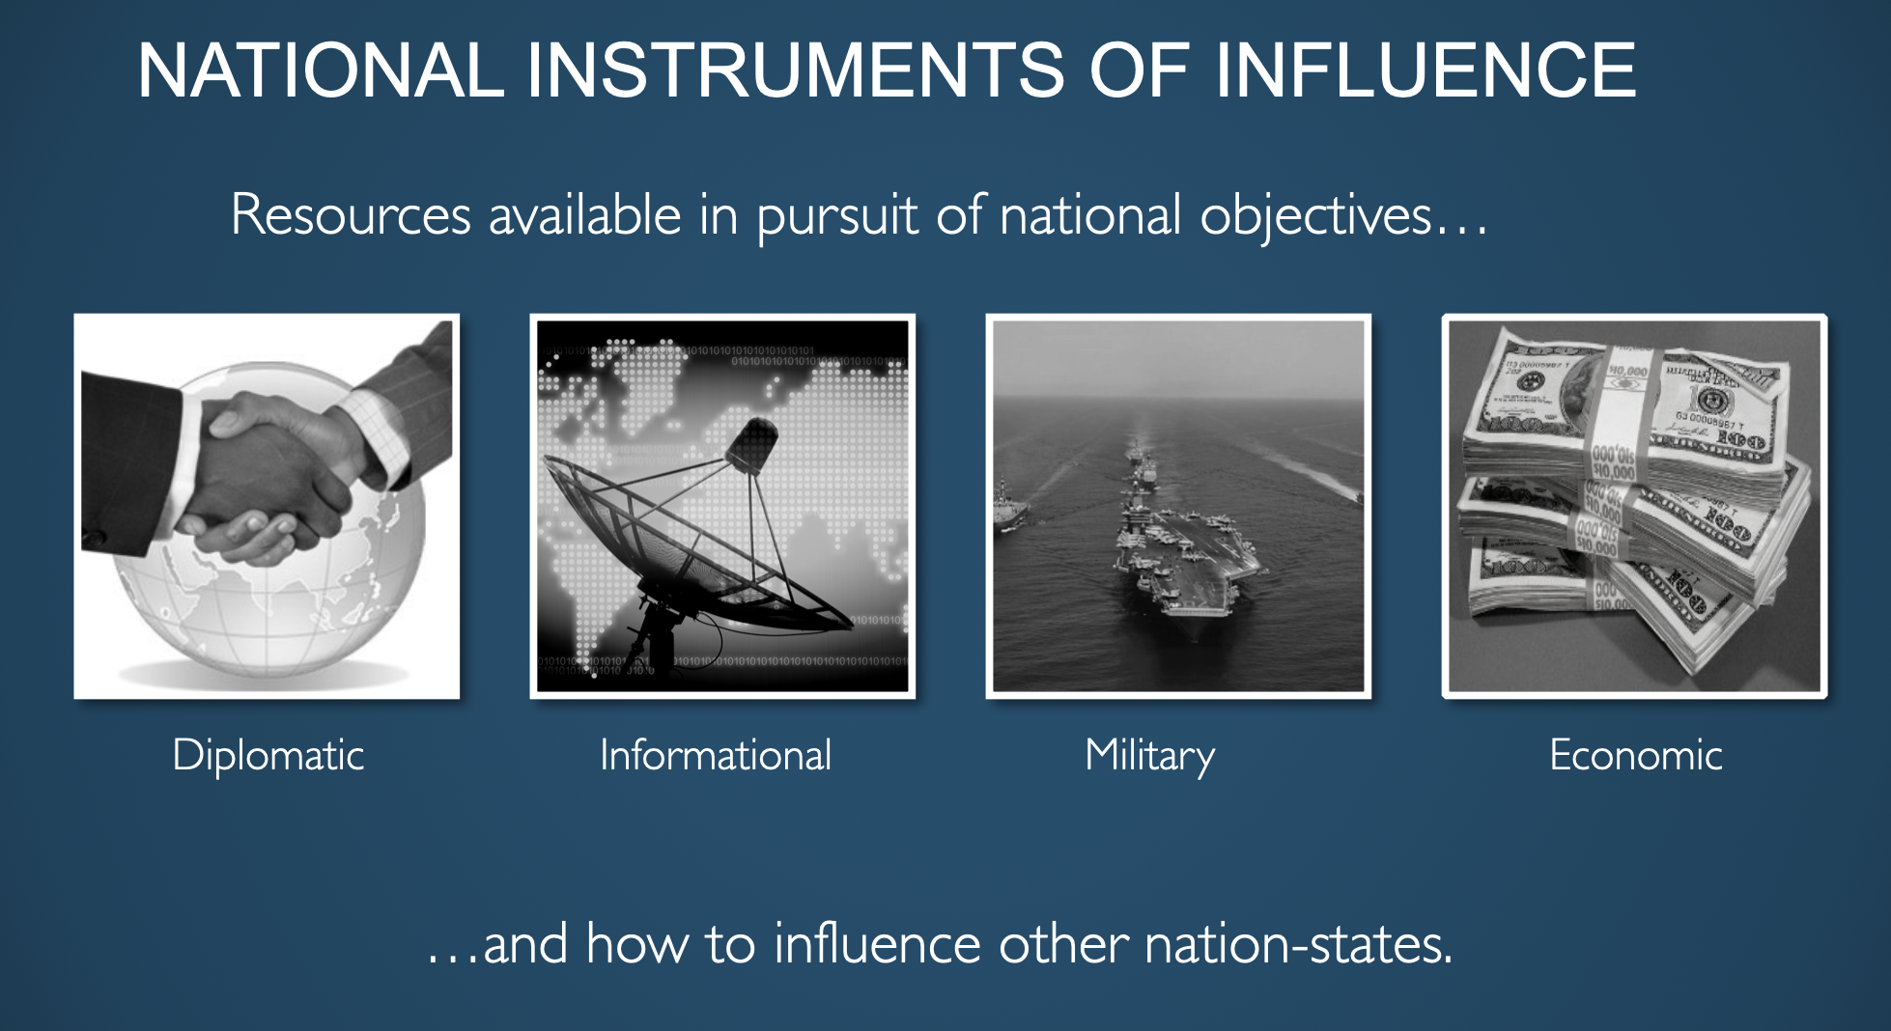
Because it’s a good way to get what you want…

Slide 20
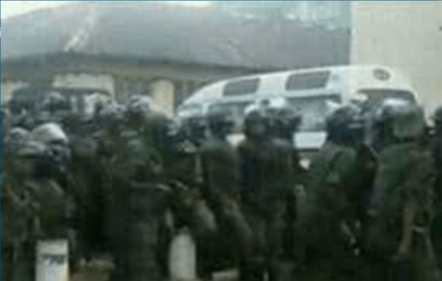
With real-world effects

Slide 21
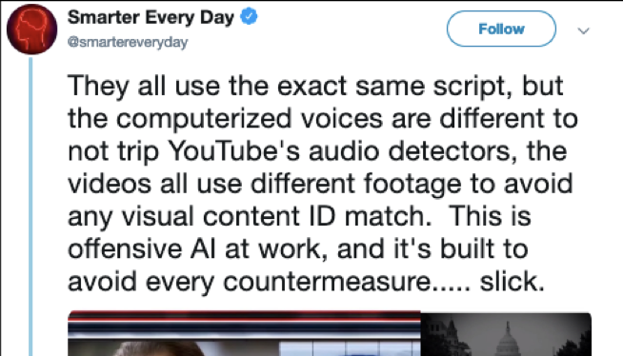
Using automation

Slide 22
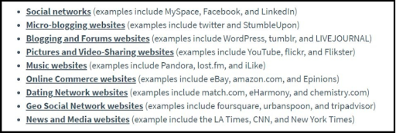
On every platform
Notes:
Image: Chris Burgess

Slide 23
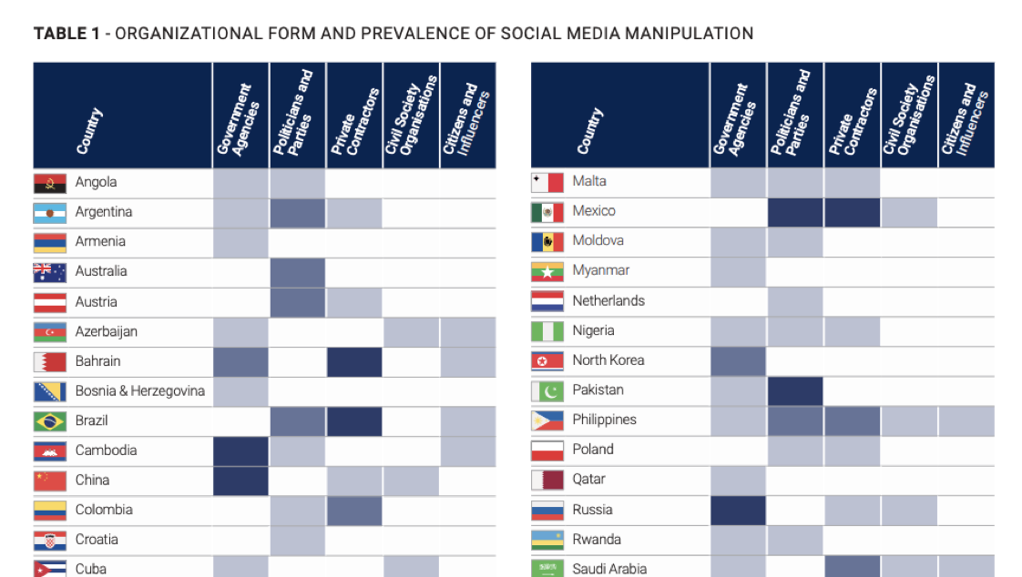
Every Country
Notes:
Table: Computational Propaganda

Slide 24
(Good places to look for countries)
https://euvsdisinfo.eu/disinformation-cases/ - Russia disinfo on EU
https://medium.com/dfrlab - world disinfo
https://comprop.oii.ox.ac.uk/ - nationstate actors
Specifically The Global Disinformation Order and https://comprop.oii.ox.ac.uk/wp-content/uploads/sites/93/2019/09/Case-Studies-Collated-NOV-2019-1.pdf
https://www.newsguardtech.com/covid-19-resources/ - c19 domains for several countries

Slide 25

Outsourcing

Slide 26
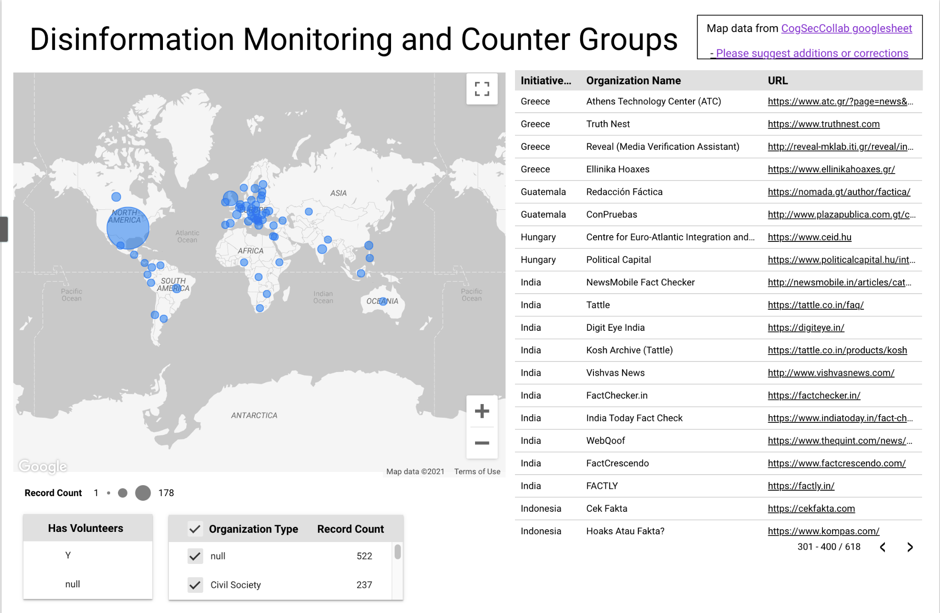
But also 1000s of responders

Slide 27
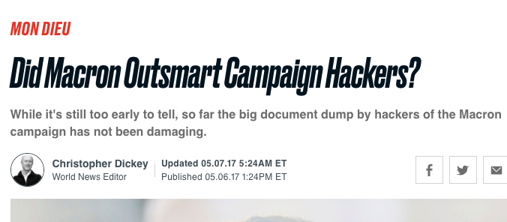
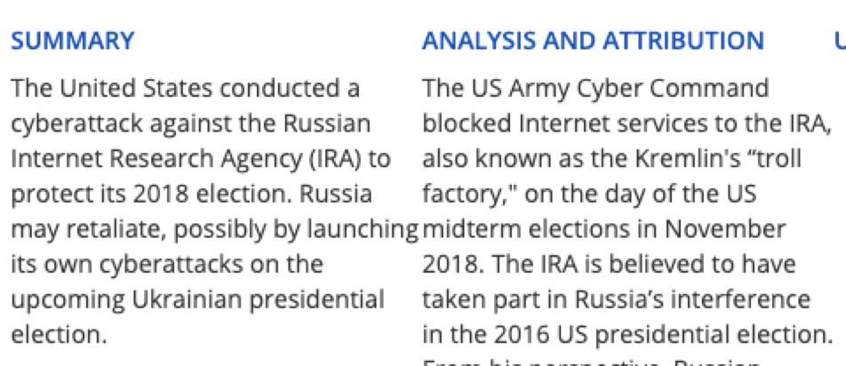
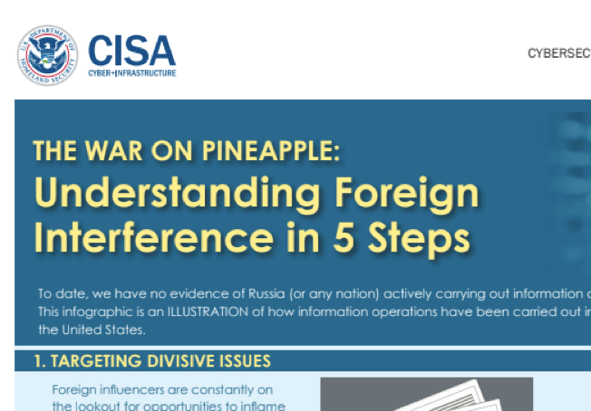
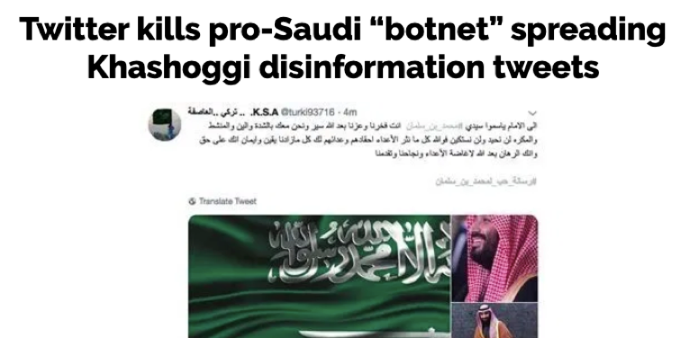
At different scales

Slide 28
So that’s what this course is about. Questions?

